Slide 1
L5 Accounting.
Team 7: Stanley, Duvall, Starlyn, zIaul, junior.

Slide 2
Client’s need.
The client wants to be able to manage the sales tax of his companies.
We also need to gather data from his other clients in order to manage all of their accounts.
Being able to manage the payments dates made to the states.

Slide 3
Budget.
For $50,000 we can provide services to his current 5 clients.
For future expansion the budget will increase depending on the number clients.

Slide 4
Requirements.
Create a website.
Create a login system for the clients.
Create a system that links two bank accounts.
Track the amount of transactions in the sales account and the amount of sales tax in the Escrow account for every client.
Send or display a statement to the client for monthly transactions.
5 clients and 5 different POS(point-of-sales).

Slide 5
Analysis.
Project Specifications:
Front-End in HTML/CSS and JavaScript.
Back-end in Python, SQL, and JavaScript programming Language.
JavaScript code processes the data in CSV files and takes the income and adds it to the account Balance.
The sales tax gets added to the Escrow account. From the Escrow account it goes to it’s respective states. NY, NJ, CT, Chicago, and etc.

Slide 6
Methods of communication.
1) In person meetings either after class or on Fridays.
2) WhatsApp messenger.
3) Email.
4) Storage on Google Drive and GitHub.
5) GitHub: https://github.com/Physsi07/Accounting-Practice-Software- Engineering-

Slide 7
Team Formation.
Synchronize-and-Stabilize Teams.
a. Products consist of 4 sequential builds
b. Small parallel teams:
i. 5 developers. ii. We test each other’s code. iii. The team is given the overall task specification.
iv. We design the task as we wish.

Slide 8
Current Model of Solution.
Python Program.
Connects to MySQL database.
Reads The Data-tables.
Gives Graphical User Interface to take the input. Adds the user inputs to database/SQL table.
Process the HTML pages.

Slide 9
Roles.
Stanley, Starlyn, Junior(front-end) - development of login page and user interface.
Duvall, Ziaul(back-end) - process information, insert and retrieve information from the database, generate reports.

Slide 10
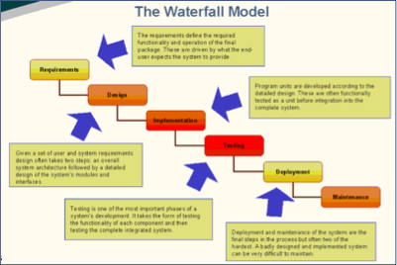
Life Cycle Model.
The waterfall model is a relatively linear sequential design approach for certain areas of engineering design. In software development progress flows in largely one direction ("downwards" like a waterfall). As well as “mix-and-match” as needed.

Slide 11
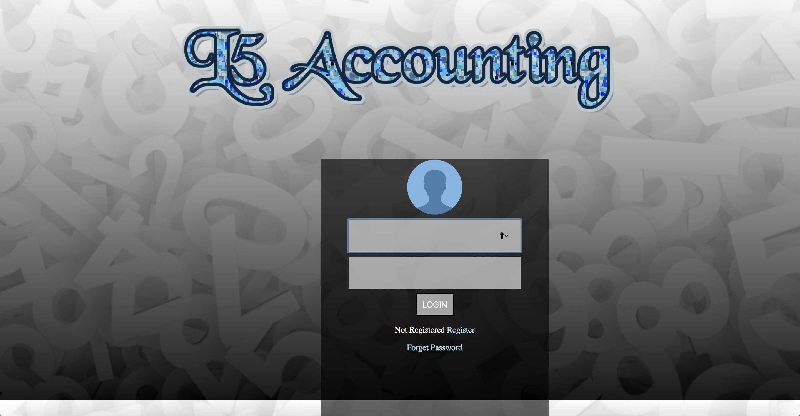
Website.

Slide 12
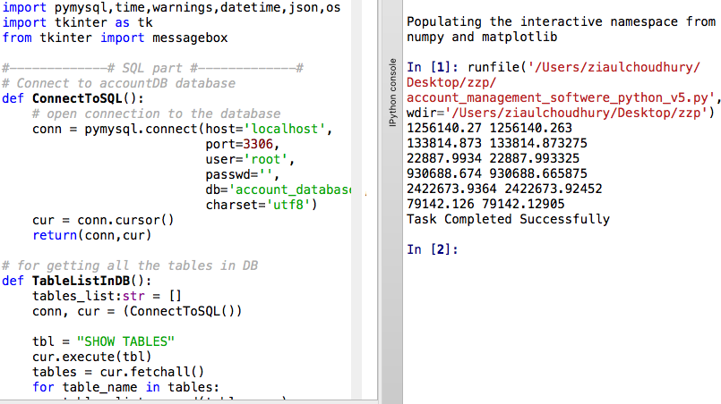
Backend Development (Python).
Screen-shot
Python Interactive IDE:
☻ Connects to the database.
☻ Reads client(s)’ data.
☻ Provides Graphical User Interface for the user inputs.
☻ Adds new data to database from the user inputs.
☻ Generates HTML reports (recent, monthly, quarterly tax, all, and summary).

Slide 13
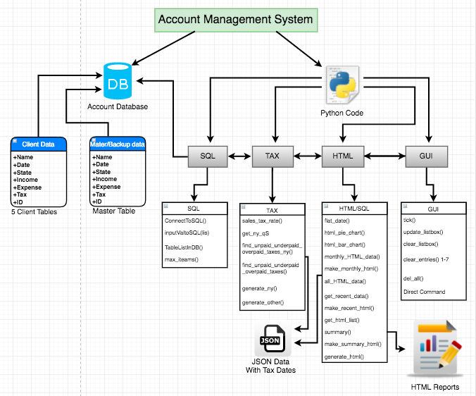
UML Model for the Application.

Slide 14
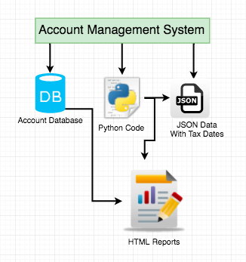
Simple UML and Some Pros.
Simple UML
Pros
Dynamic (able to add new client if need in future).
Robustness (validates input for some parts).
Reusability (objects and classes can be reused).
Portability(can run on Windows or MAC OS).
Data encapsulation (data is hidden to the other individual users except for the admin).

Slide 15
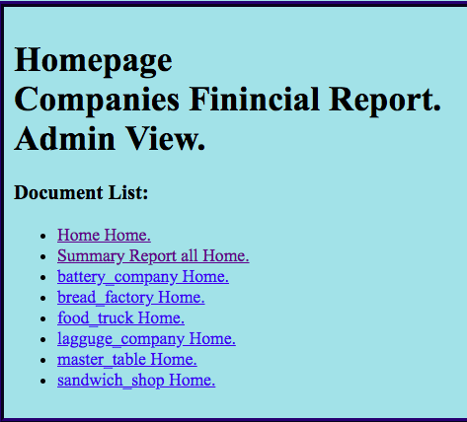
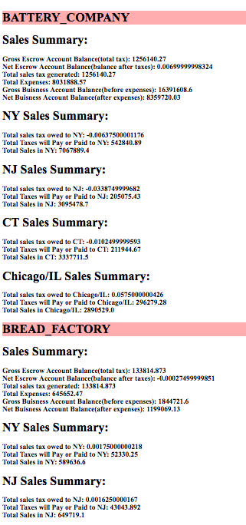
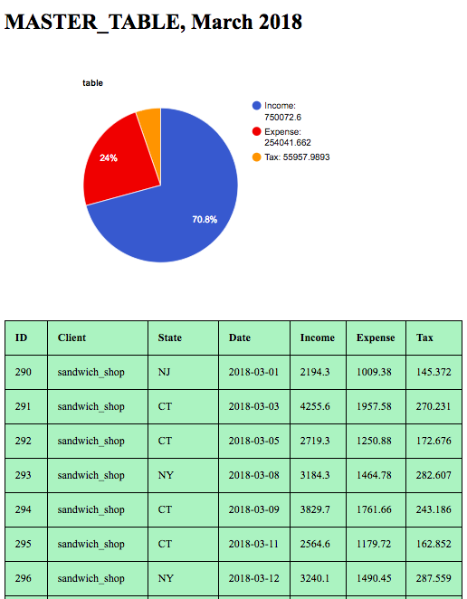
Homepage & Reports.
Admin Homepage
Summary
Monthly Report

Slide 16


Compatibility & Portability.
This software will run on any windows or mac OS operating system.
This software can accessed using any mobile devices with internet access and any desktop.

Slide 17
Task Schedule.
04/30/2018 - Complete the Website.
05/1/2018 - QA testing phase(on going at all times!).
05/10/2018 - Acceptance test.
05/20/2018 - Deployment.

